Slide 1
RADIATION PHYSICS

Slide 2
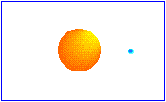
CONTENTS
Historical review
Definitions
Atomic model
Binding Energy
Excitation and Ionisation
Nature of radiation
X-Ray Machine
X-Ray tube power
Production of X rays
Interaction of X-Rays with Matter
Dosimetry
Conclusion
Bibliography

Slide 3
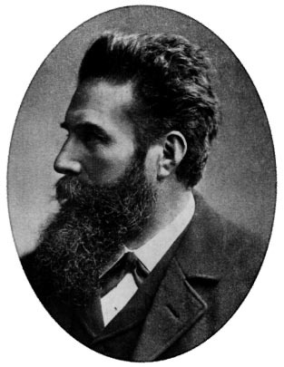
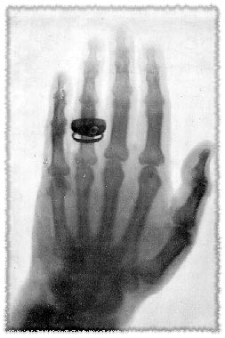
Radiation History
In 1838, Heinrich Geissler, built the first vacuum tube called as Geissler tube and which later following various modifications as Hittorf-Crookes tube & Lenard tube.
In 1913, William D. Coolidge developed the first hot cathode x-ray tube.
In 1870, Johann Wilhelm Hittorf, observed the discharges emitted from the negative electrode of the tube which travelled in straight lines, producing heat & green fluorescence----cathode rays.
Wilhelm Conrad Roentgen, a Bavarian physicist discovered X-ray on Nov 8, 1895.

Slide 4
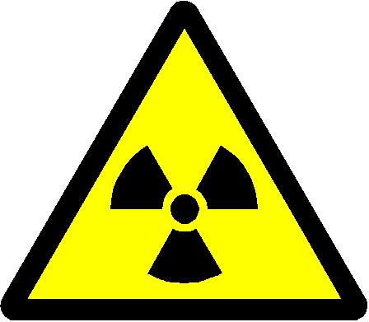
Definitions
Radiation:
A form of energy carried by waves or a stream of particles.
X-radiation:
A high-energy radiation produced by the collision of a beam of electrons with a metal target in an x-ray tube.
X-ray:
A beam of energy that has the power to penetrate substances & record image shadows on photographic film.
Radiology:
The science or study of radiation as used in medicine; a branch of medical science that deals with the use of x-rays, radioactive substances, & other forms of radiant energy in the diagnosis & treatment of disease.
Radioactivity :
Process by which certain unstable atoms or elements undergo spontaneous disintegration or decay, in an effort to attain a more balanced nuclear state.

Slide 5
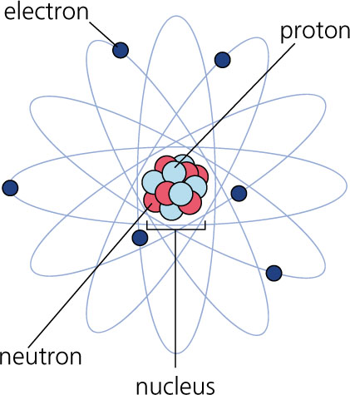
MATTER
Matter is anything that has mass & occupies space.
Three states- solid, liquid & gas with atoms forming a fundamental unit.
When matter is altered it results in energy.
Bohr viewed the atom as a miniature solar system with a nucleus at the centre and revolving electrons.
Identity of an atom depends upon its composition of the nucleus & arrangement of electrons. (118)

Slide 6
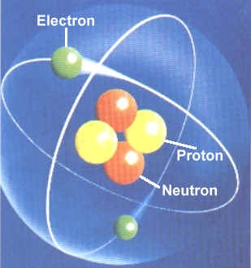
Subatomic particles
Nucleus-
Dense core of an atom & composed of protons & neutrons.
Protons-
These are the positive charged elementary particles.
The number of protons inside the nucleus equals the number of electrons outside the nucleus .
The number of protons inside the nucleus is also the Atomic Number (Z) of that element.
Mass = 1.66 X 10⁻²⁷ kg
Charge = +1.6 X 10⁻¹⁹ Coulombs

Slide 7
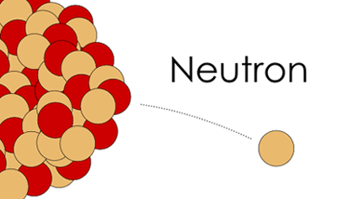
NEUTRONS
These are not charged & act as binding agents within the nucleus and hold it together by counteracting the repulsive forces between the protons.
Mass = 1.70 X 10⁻²⁷ kg
Charge = NIL
The number of protons & neutrons in the nucleus of an atom determines its mass number/atomic wt.

Slide 8
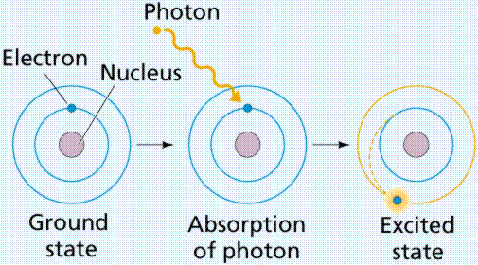
ELECTRONS
ELECTRONS are tiny negatively charged particles that has very little mass, it weighs 1/1800 of proton or neutron .
Electrons travels around nucleus in well defined paths known as orbits or shells.
An atom contains maximum of 7 shells, each located at specific distance from the nucleus.
Electrons are maintained in the orbit by electrostatic force or attraction between positive nucleus and negative electrons known as binding force or binding energy (keV).
To excite an electron to a shell farther from the nucleus, supply energy, & vice versa to move closer to the nucleus.

Slide 9
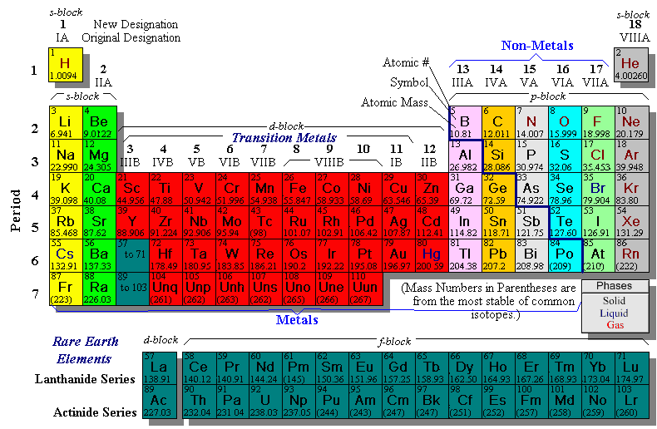

Slide 10
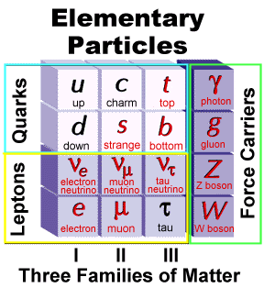
Standard Model (1930)
12 types of fundamental matter particles plus their corresponding antiparticles.
These are called as fundamental particles as they do not have inner structure & cannot be further divided.
Universe=24% matter +76% dark energy
5% atoms & neutrinos
EMF
Strong nuclear forces
Weak
forces
Protons=2up +1down
Neutron=1up+2down
EMF=electromagnetic forces
Gravitons=gravity

Slide 11
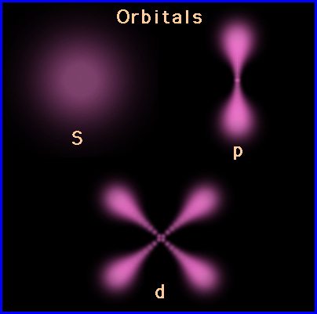
The Quantum Mechanical Model
Describes about arrangement of electrons in an atom.
The shells also have numbers for identification :
1 for K shell
2 for L shell and so on.
These are the principal quantum numbers and are represented by the letter ‘n’
The maximum number of electrons in a given shell is 2n² (where n is principal quantum number)
Angular momentum quantum no-l-s,p,d,f,g,h= n-1=0 to 5
Magnetic quantum no-m-orientation of an orbital in space.

Slide 12
Ionization
Ionizing Radiation
Particulate radiation
Electromagnetic radiation
Ionization is the production of ions or process of converting atom into an ion.
The atom which gains the electron will be negatively charged and which looses the electron will be positively charged .
Ionizing radiation can be defined as radiation that is capable of producing ions by removing or adding an electron to an atom.

Slide 13
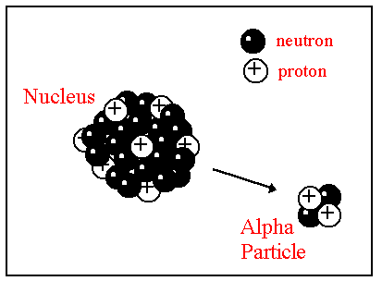
Particulate Radiation
These are tiny particles of matter that possess mass & travel in straight lines & at high speeds.
They transmit kinetic energy by means of their extremely fast –moving, small masses.
Alpha particles are emitted from the nuclei of heavy metals and exist as two protons and two neutrons, without electrons.
Beta particles are fast moving electrons emitted from nuclei of radioactive atoms.
Gamma rays are photons, a form of electromagnetic radiation & results as a part of decay chain where a massive nucleus produced by fission converts from a excited state to a lower-level ground state.

Slide 14
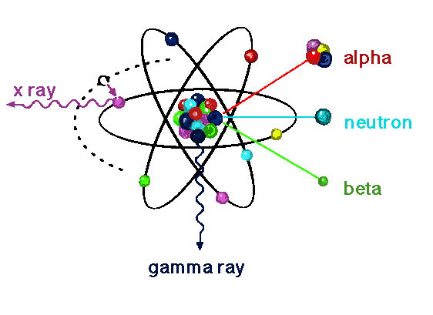
Particle Mass units Charge Origin
Alpha 4.003000 +2 Nucleus
Electron
Beta particle 0.000548 -1 Nucleus
Electron
Cathode rays 0.000548 -1 X-Ray tube

Slide 15
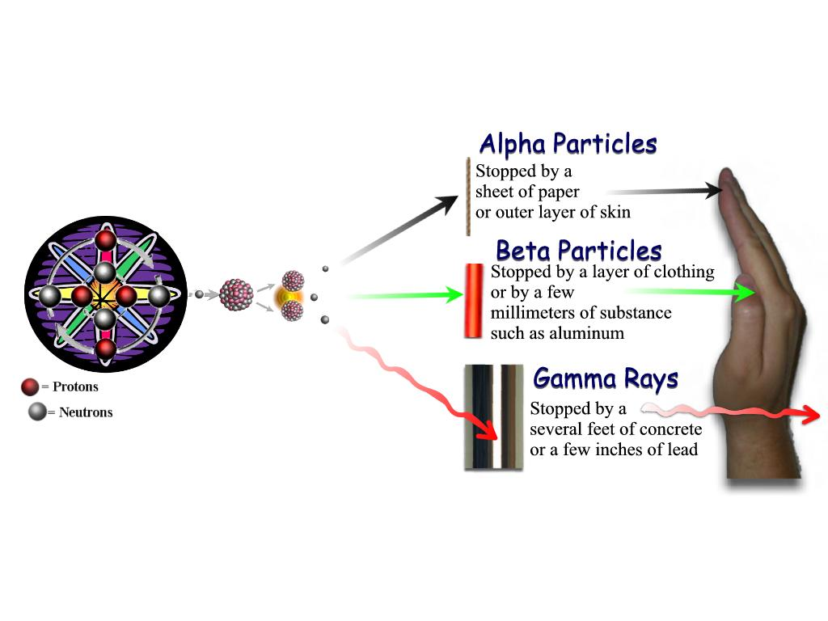
LINEAR ENERGY TRANSFER
The capacity of particulate radiation to ionize atoms
depends on its mass, velocity and charge.
The rate of loss of energy from a particle as it moves along its track through matter [ tissue] is its ‘Linear energy transfer’
Greater the physical size and charge and lower the velocity of the atom, then greater is its linear energy transfer.
Alpha particles have high linear energy transfer than Beta particles.

Slide 16
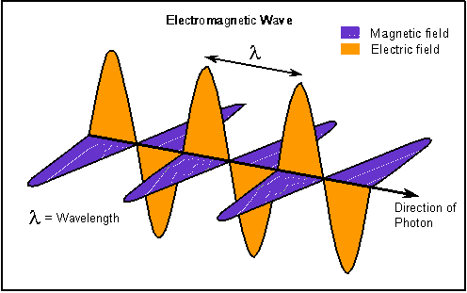
Electromagnetic Radiation
Movement of energy through space as a combination of electric and magnetic fields.
It is generated when the velocity of an electrically charged particle is altered.

Slide 17
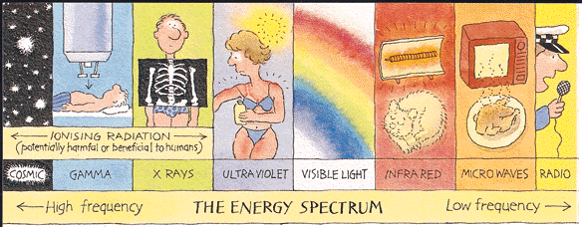
Depending on the energy levels, electromagnetic radiation are divided into ionizing & non-ionizing radiations.
10 ⁻⁷ 10⁻⁵ 10⁻³ 10⁻¹ 10 10³ 10⁵ 10⁷ 10⁹ 10¹¹ 10¹³ nm
ENERGY
WAVE LENGTH
FREQUENCY

Slide 18
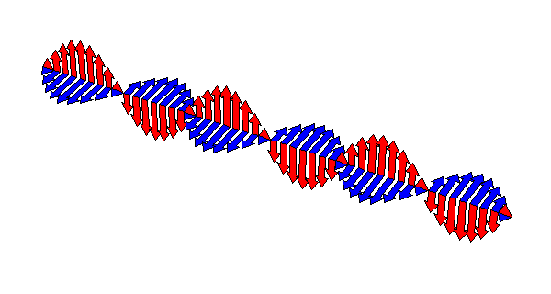
Properties of Electromagnetic Radiation :
Have no mass or weight
Have no electric charge
Travel at speed of light
Travel as both particle and wave
Propagate an electric field at right angles to path of travel
Propagate a magnetic field at right angles to the electric field
Have different measurable energies
Theories of electromagnetic radiation:
Some of the properties of electromagnetic radiation are best expressed by wave theory, where as others are most successfully described by quantum theory.

Slide 19
QUANTUM THEORY
This theory considers electromagnetic radiation as small bundles of energy called photons/quanta.
Each photon travels at speed of light and contains specific amount of energy.
The relationship between wavelength and photon energy is
E = h x c /λ
Where E = energy in KeV
h = planck’s constant(6.626068 × 10⁻³⁴ J-Sec)
c = velocity of light
λ = wavelength in nm
Explains interaction of radiation with atoms,photoelectric effect & x-rays production

Slide 20
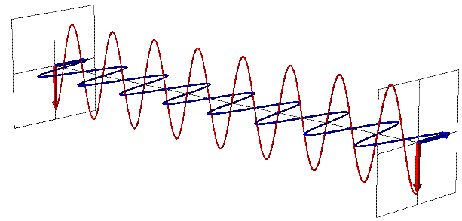
WAVE THEORY
According to this theory , radiation is propagated in the
form of waves.
Such waves consist of electric and magnetic fields oriented in planes at right angles to one another that oscillate perpendicular to the direction of motion.
λ×υ= C -----(λ in mts & υ in cycles per sec)
Explains refraction, reflection, diffraction, interference & polarization.

Slide 21
X-RADIATION
It is a high energy, ionizing electromagnetic radiation which have the properties of both waves and particles.
X-rays can be defined as weightless bundles of energy
{photons} without an electric charge that travel in waves
with a specific frequency at speed of light.
X-ray photons interact with materials they penetrate and
cause ionization.

Slide 22
PROPERTIES OF X-RAYS
Invisible and cannot be detected by any of the senses.
Have no mass or weight.
Have no charge.
Travel at the speed of light (3 x 10⁸ m/sec)
Travel in waves and have short wavelengths with a high frequency.
X-rays travel in straight lines and can be deflected or scattered.
X-rays cannot be focused to a point and always diverge from a point.
X-rays can penetrate liquids, solids and gases. The composition of the substance determines whether x rays penetrate, pass through or are absorbed.
X-rays are absorbed by matter; the absorption depends on the atomic structure of matter and the wavelength of the X-ray
X-rays interact with materials they penetrate and cause ionization.
X-rays can cause certain substances to fluorescent or emit radiation in longer wavelengths.
X-rays can produce an image on photographic film.
X-rays cause biological changes in living cells.
They don’t require medium to propagate

Slide 23
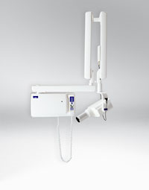
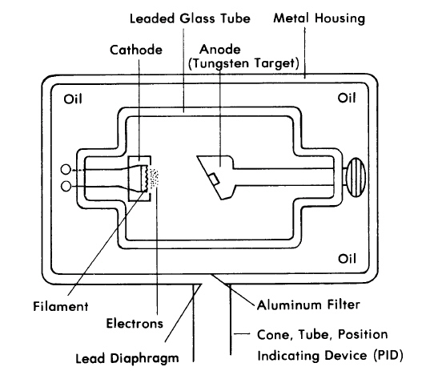
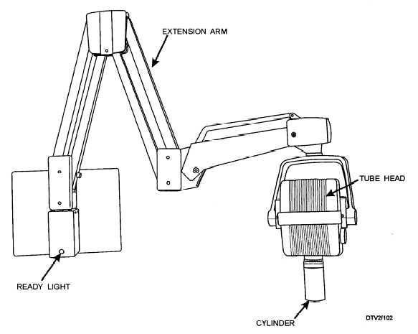
X-RAY MACHINE
The Dental x-ray machine is made up of three parts or components.
A. Control panel
B. Extension arm
C. Tube head-tightly
sealed, heavy metal
housing.

Slide 24
X-Ray tube
The heart of X-ray machine is the X-ray tube and its power supply.
The X-ray tube is positioned within the tube head, along with some components of power supply.
The component parts of the X-ray tube include a leaded glass housing, negative cathode and a positive anode.

Slide 25
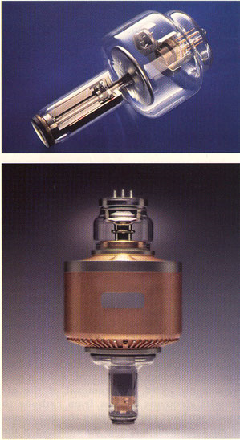
Leaded glass housing
The leaded glass housing is a leaded glass vacuum tube that prevents x rays from escaping in all directions.
One central area of the leaded glass tube has a “window” that permits the x ray beam to exit the tube and directs the X-ray beam toward the aluminum disks, lead collimator and Position Indicating Device.
Importance of vacuum

Slide 26
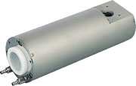
Metal ceramic x-ray tubes
It has a metal casing instead of the usual glass envelope.
3 ceramic insulators---2 for high voltage cables and 1 for the anode stem
Rotating anode with 2 bearings supporting it at each ends
Less off focus radiation
Longer tube life with high currents
Higher tube loading
The metal envelope is grounded & the usage of ceramic adds to the electrical safety despite the tube’s small size.

Slide 27
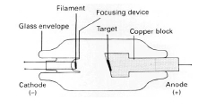
Cathode
It is principally composed of two parts .
1. filament. – tungsten wire (coiled to form a vertical spiral of 2 mm diameter and 1 cm length)
2. focusing cup- negatively charged concave reflector(Molybdenum or nickel)
Thermionic emission : Emission of electrons resulting from absorption of thermal energy.
Heated to 2200 C
Forms an electron cloud – Edison effect
Creates a “Space charge” which restricts more
electrons to emit – Space Charge Effect

Slide 28
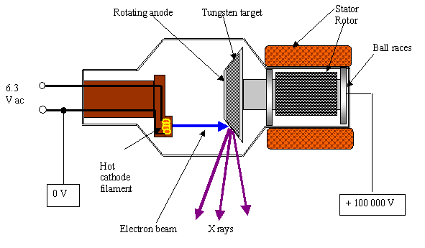
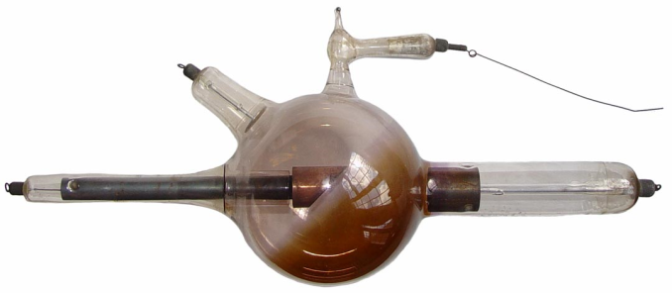
Anode
The anode, or positive electrode, consists of a tungsten plate embedded in a solid copper rod.
Stationary or fixed
Rotating
Tungsten is preferred as
High melting point ( 3370 C )
High thermal conductivity
High atomic number (74)
Can be drawn into thin wires that are quite strong
Low vapour pressure
Disadvantage-------sunburn effect

Slide 29
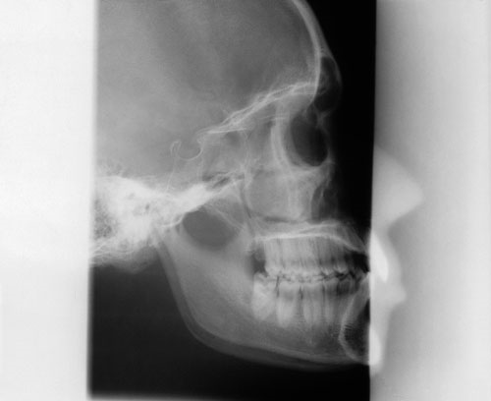
Off-Focus Radiation
Metal housing produces lesser “off focus radiation” as the extra electrons produced are attracted towards the grounded metal housing instead of forming x ray photons

Slide 30
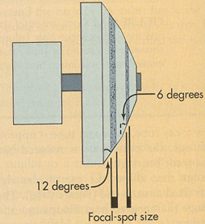
Focal spot/Benson line focus principle (1918)
Focal spot is the area on the target to which the focusing cup directs the electrons & from which x-rays are produced.
Larger area will dissipate heat better but also decreases the sharpness of the image.
Hence the concept of having a larger focal spot area ( Actual focal spot – 1x3mm ) with a tilted anode thereby decreasing the apparent size ( effective focal spot – 1x1mm).
Target is tilted to an angle
of 15 – 20 degrees

Slide 31
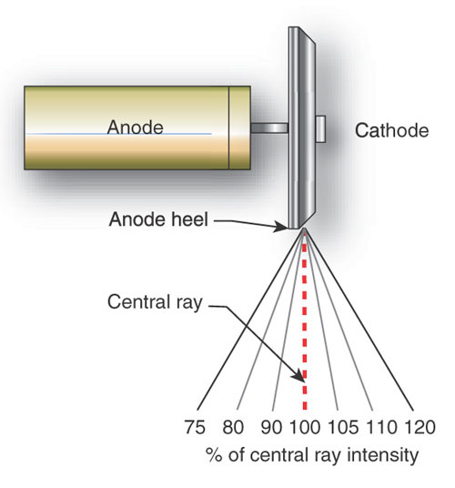
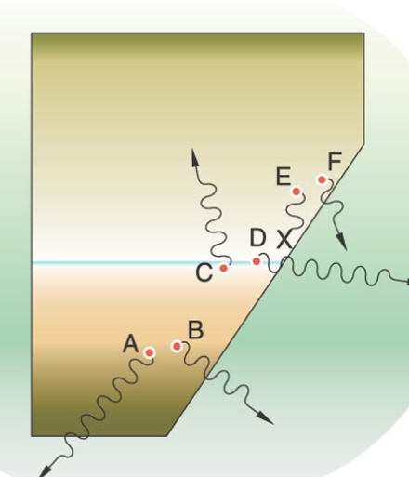
Heel Effect
The intensity of the x-ray beam that leaves the x-ray tube is not uniform throughout all portions of the beam.
The intensity of the beam depends upon the angle at which the x-rays are emitted from the focal spot.
Due to the geometry of the angled anode target, the radiation intensity is greater on the cathode side.
Less in larger focus-film distances
Less in smaller films
Thicker body part placed near cathode end

Slide 32
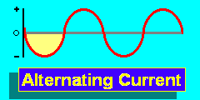
Power supply– tube current
DC- electrons flow in one direction
AC- electrons flow in two opposite
directions
Circuits– path of electrical current.
Direct Current
Low voltage/filament circuit
3-5 volts
Flow of current to the filament of the x-ray tube---mAm
High voltage
65,000-100,000 volts
To accelerate electrons & to generate x-rays---kV

Slide 33
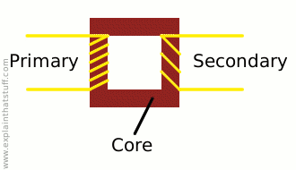
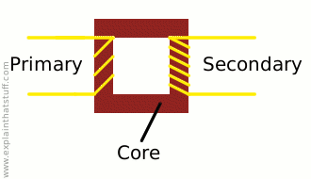
Transformers
A transformer is a device that is used to either increase or decrease the voltage in an electric circuit.
Step-down transformer:
decrease the voltage from the incoming 110 or 220 line voltage to 3 to 5 volts
Step –up transformer:
increases the voltage from the incoming 110 or 220 line voltage to 65,000 to 1,00,000 volts
Autotransformers :voltage compensator that corrects for minor fluctuations in the current.
Step down
Step up

Slide 34
Rectification
It is the conversion of AC to DC
Half wave or self rectified:
Full wave rectified:
Inverse voltage /reverse bias
Longer contrast scale
Lower patient radiation exposure dose

Slide 35
Timer
A timer is built into high voltage circuit to control the
duration of x ray exposure.
The timer controls the length of time that high voltage is
applied to the tube and therefore the time during which
tube current flows and X-rays are produced.
To minimize filament burnout, the timing circuit first sends a current through the filament for about half a second to bring it to proper operating temperature.
After the filament is heated, the timer then applies power
to the high voltage circuit.

Slide 36
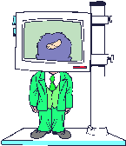
Tube rating and duty cycle
Heat build up at anode (units : HU ) = Kvp x mA x Sec
For dental diagnostic tubes – it is 20 kHU.
Each X-ray machine comes with tube rating specifications that describe the maximal exposure time the tube can be energized without risk of damage to target from overheating.
Duty cycle relates to frequency with which successive
exposures can be made.
It is a characteristic dependent on anode size & method used for cooling it.

Slide 37
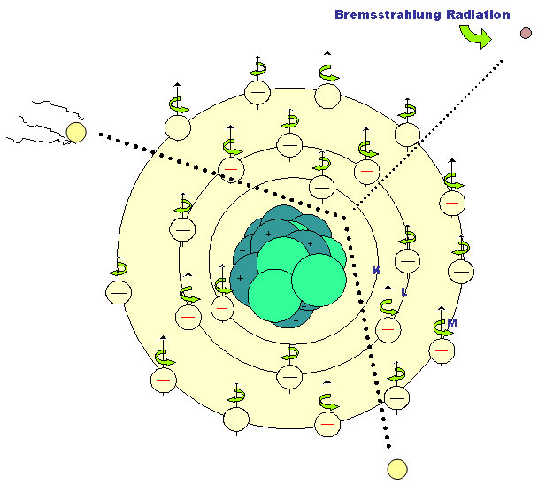
Bremsstrahlung radiation (produced majorly)
Characteristic radiation
In German it is called as braking radiation.
The energy of the x-ray photon is identified by the peak operating voltage.

Slide 38
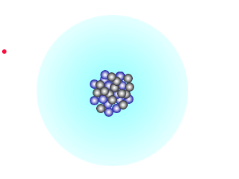
Bremsstrahlung Radiation
Bremsstrahlung interaction generates a continuous spectrum of energy.
The reason for this continuous spectrum are as follows :
The continuously varying voltage difference between the target and the filament, which is characteristic of half-wave rectification, causes the electron striking the target to have various levels of kinetic energy.
The bombarding electrons pass at varying distances around tungsten nuclei and are thus deflected to varying extents.
Most electrons participate in many Bremsstrahlung interaction in the target before losing all their kinetic energy – thereby having different energies.

Slide 39
Characteristic radiation
Small fraction of the x-ray photons
Represents the characteristic of the target atom

Slide 40
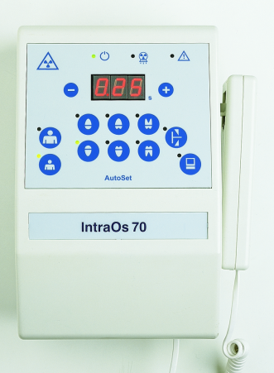
FACTORS CONTROLLING X-RAY BEAM
The X-ray beam emitted from an X-ray tube may be modified by altering the beam exposure length [timer], exposure rate [ma], beam energy (KVp & filtration), beam shape {collimation} and intensity (target patient distance).
Exposure time : When the exposure time is doubled while the tube current and voltage remain constant, the number of photons generated at all energies in the X-ray emission spectrum is doubled
Changing the time simply controls the quantity of the exposure, the number of photons generated.

Slide 41
Tube Current
Tube current [ma] : Increasing tube current while maintaining constant tube voltage [Kvp] and exposure time, increases the power applied to the filament which heats up and releases more electrons that collide with the target to produce radiation.
mA – directly proportional to quantity of photons
The quantity of radiation produced is expressed as the product of time & tube current.
The term beam intensity/quantity refers to the number of photons in an x-ray beam.

Slide 42
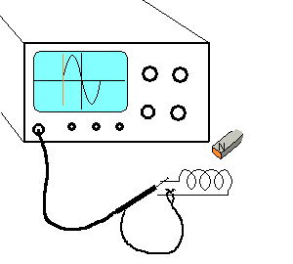
Tube Voltage
Increasing the voltage increases the potential difference between the cathode and anode thus increasing the energy of each electron when it strikes the target.
kVp – directly proportional to the quality photons
This results in an increased efficiency of conversion of electron energy into X-ray photons, and thus increase in
1.The number of photons generated.
2.Their mean energy.
3.Their maximal energy.
High energy X-ray photons have a greater probability of penetrating matter whereas relatively low energy photons have a greater probability of being absorbed.
Therefore the higher KVp and mean energy of the X-ray beam(beam quality), the greater the penetrability of the beam through matter.

Slide 43
Half value layer (HVL)
It is the thickness of an absorber, such as aluminium , required to reduce by one half the number of x-ray photons passing through it.
As average energy of an x-ray beam increases, so does the HVL.

Slide 44
Filtration
Low energy X- ray beam contribute to patient exposure
but do not have enough energy to reach the film.
This can be accomplished by placing an aluminum filter in the path of the X-ray beam. The aluminum preferentially removes many of the lower energy photons with lesser effect on the higher energy photons that are able to penetrate to the film.
1. Inherent filtration – calculated in Al equivalents = 0.5 to 2.0 mm of Al equivalent. Uses x-ray tube, insulating oil & tubehead seal.
2.Added/external filtration-Commonly Al disk in path of x-rays beam b/w the collimator & the tubehead seal=0.5 mm of Al.
3.Compound filter – copper + aluminium
Total filtration = inherent + added

Slide 45
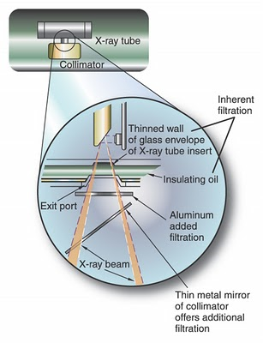
Below 50 kVp – 0.5mm Al
50 – 70 kVp – 1.5 mm Al
Above 70 kVp – 2.5 mm Al

Slide 46
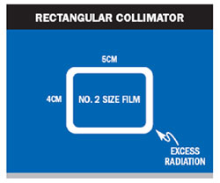
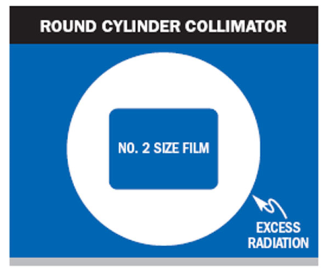
Collimation
A collimator is a metallic barrier with an aperture in
the middle used to reduce the size of the X-ray beam and therefore the volume of irradiated tissue within the patient.
Round (7 cm) and rectangular collimators are most frequently used.
When an X-ray beam is directed at a patient, the tissues absorb about 90% of the X-ray photons and 10% of the photons pass through the patient and reach the film.
Collimating the beam to reduce the exposure area and thus the number of scattered photons reaching the film can minimize the detrimental effect of scattered radiation on the images.

Slide 48
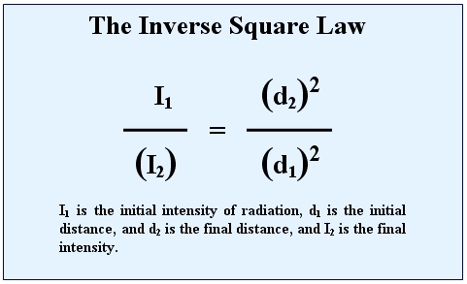
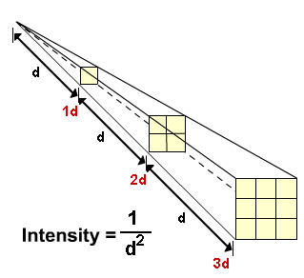
Inverse square law
Intensity of an x-ray beam at a given point (no of photons/cross sectional area/unit exposure time) depends on the distance of the measuring device from the focal spot.
For a given beam the intensity is inversely proportional to the square of the distance from the source .
The reason is that the x-ray beam spreads out as it moves away from the source

Slide 49
INTERACTION OF X-RAYS WITH MATTER
The intensity of X-ray beam is reduced by interaction with the matter it encounters. This attenuation results from interaction of individual photons in the beam with atoms in the absorber.
The X-ray photons are either absorbed or scattered out of beam.
In absorption, photons ionize absorber atoms and convert their energy into kinetic energy of ejected electrons.
In scattering, photons are ejected out of primary beam as a result of interaction with the orbital electrons of absorber atoms.

Slide 50
In a dental X-ray beam there are three means of beam attenuation:
1. Coherent scattering
2. Photoelectric absorption
3. Compton scattering

Slide 51
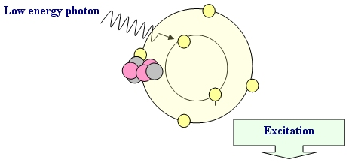
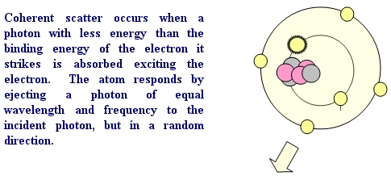
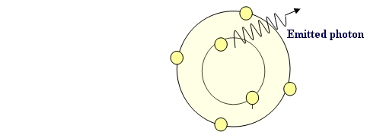
Coherent Scattering
Also called as classical, elastic .
2 types-Thompson Scattering & Rayleigh Scattering.
Accounts for only 7% of total number of interactions in an exposure
Essentially, the X-ray photon is “unmodified” and simply
undergoes a change in direction without a change in
energy.

Slide 52
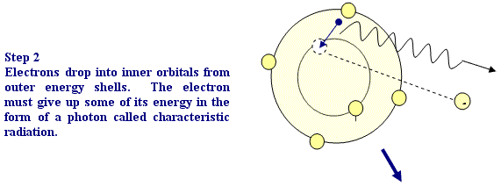
Photoelectric Absorption

Slide 53
The photoelectric effect accounts for 23% of the interactions of matter in the dental X- ray beam.
The frequency of photoelectric interaction varies directly with the third power of the atomic number of the absorber.
E.g. the effective atomic number of compact bone (Z = 13.8) is greater than that of the soft tissue (Z = 7.4), the probability that a photon will be absorbed by photoelectric interaction in bone is 6.5 times greater than in an equal thickness of soft tissue.
This difference is readily seen on dental radiographs as a difference in optical density of the image. It is this difference in the absorption that makes the production of a radiographic image possible.

Slide 54
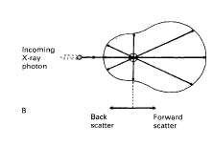
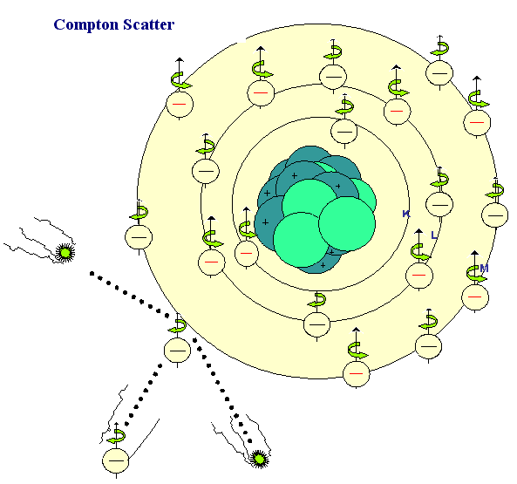
Compton Radiation
Accounts for 49% of interactions.
Depends on the electron density of the subject. Hence more in bone than in soft tissues
Scattered photons can be deflected in any direction, but the angle of scatter depends on their energy. High-energy scattered photons produce forward scatter; low-energy scattered photons produce back scatter
Forward scatter may reach the film and degrade the image, but can be removed by using an anti-scatter grid
The overall result of the interaction is ionization of the tissues.

Slide 55
The importance of photoelectric absorption and the Compton Scattering in diagnostic radiography relates to the differences in the way photons are absorbed by various anatomic structures.
The number of photoelectric and Compton interactions is greater in hard tissues than in soft tissues. As a consequence, more photons in the beam exit the patient after passing through soft tissue than through hard tissue.
Thus while the incident beam (the beam striking the patient) is spatially homogenous, the remnant beam (the beam that exits the patient) is spatially heterogeneous

Slide 56
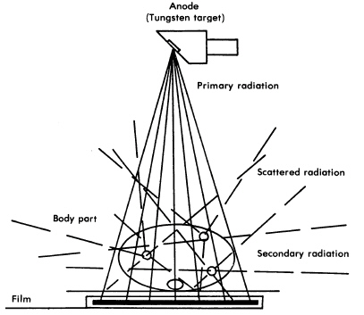
Secondary Electrons
In both photoelectric absorption and Compton scattering electron are ejected from their orbits in the absorbing material after interaction with X-Ray photons.
These secondary electrons give up their energy in the absorber by either two processes :
(1) Collisional interaction with other electrons, resulting in ionization or excitation of the affected atom, and
(2) Radiative interactions, which produce Bremsstrahlung radiation, resulting in the emission of low-energy X-Ray Photons.
Secondary electrons eventually dissipate all their energy, mostly as heat by collisional interactions, and come to rest.

Slide 57
Beam Attenuation
As an X-Ray beam travels through matter, its intensity is reduced (attenuated).
In a monochromatic beam , when only the primary (not scattered) photons are considered, a constant fraction of the beam is attenuated as the beam moves through each unit thickness of an absorber. Therefore 1.5cm of water may reduce a beam intensity by 50%. The next 1.5cm of water may reduce a beam intensity by another 50% (to 25% of the original intensity), and so on. This is an exponential pattern of absorption.
When the energy of the incident photon is raised to match the binding energy of the 1s orbital e- of the absorber, then the probability of photoelectric absorption increases & number of transmitted photons decreases----K edge absorption.

Slide 58
Rare Earth filters/heavy metal filters
The term K-edge filter as used in this paper describes the use of any filtering material that demonstrates a K-edge within the useful energy range of the X-ray beam employed.
However, in previous studies the term K-edge filter was applied to those materials that not only filtered the lower photon energy end of the spectrum but also the higher photon energies, resulting in a "bandpass" effect (Nagel, 1989). This is the case for erbium.
The term pseudo-K-edge filters was applied to those filters that only removed the lower photon energies (Nagel, 1989) as is the case with niobium and yttrium.
The effect of thin K-edge filters on radiation dose in dental radiography
1992, The British Journal of Radiology, 65, 990-995

Slide 59
Dosimetry
Determining the quantity of radiation exposure or dose is dosimetry.
The term dose is used to describe the amount of energy absorbed per unit mass at a site of interest.
Exposure is a measure of radiation based on its ability to produce ionization in air under standard conditions of temperature and pressure. [STP]

Slide 60
Radiation absorbed dose (D)
This is the measure of the amount of energy
absorbed from the radiation beam per unit mass
of tissue.
Equivalent dose (H)
This is a measure which allows the different radiobiological effectiveness (RBE) of different types of radiation to be taken into account.
For example, alpha particles penetrate only a few millimeters in tissue, loose all their energy and are completely absorbed, whereas X-rays penetrate much further, loose some of their energy and are only partially absorbed.
The biological effect of a particular radiation absorbed dose of Alpha particles are more severe than a similar radiation absorbed dose of X-rays.

Slide 61
Equivalent dose (H) = Radiation absorbed dose (DT) x Radiation weighing factor(WR)
Effective dose (E) :
This measure allows doses from different investigations of different parts of the body to be compared by converting all doses to an equivalent whole body dose.
Effective dose (E) = Sum of [Equivalent dose(H) x Tissue weighing factor(Wt)]
Radioactivity : Radioactivity (A) describes the decay rate of a sample of radioactive material.

Slide 62
Radiation quantities & units
_________________________________________________________________
QUANTITY S.I. UNIT TRADITIONAL CONVERSION
_______________________________ UNIT______________________________
Exposure Air kerma Roentgen (R) 1 C/Kg=3876 R
Absorbed dose Gray (Gy) Rad 1Gy = 100rad
Equivalent Dose Sievert (Sv) Rem 1Sv = 100rem
Effective Dose Sievert (Sv) --- ---
Radioactivity Becquerel (Bq) Curie (Ci) 1Bq = 2.7 x 10⁻¹¹ Ci
1Ci = 3.7 x 10 ¹⁰ Bq

Slide 63
Conclusion
Radiography is a highly technical field, indispensable to the modern dental practice, but presenting many potential hazards.
The basics of radiation physics aids in the understanding of both the useful and the harmful aspects of radiation.

